Slide 1
Unit5: Syntax Directed Translation
Programming language execution engine

Slide 2
Execution engine (Java)
Central Component of the java virtual machine(JVM).
communicates with various memory areas of the JVM.
Each thread of a running application is a distinct instance of the virtual machine’s execution engine.
Executes the byte code which is assigned to the run time data areas in JVM via class loader.
Java Class files are executed by the execution engine.

Slide 3
Three main components for executing Java Classes.
Interpreter
Just-in-time (JIT) compiler
Garbage Collector

Slide 4
Interpreter
Reads the byte code and interprets into the machine code and executes them in a sequential manner.
Runs the application from the command line by accepting a filename argument.

Slide 5
Just-in-time (JIT) compiler
Counterbalances the interpreter’s disadvantage of slow execution and improves the performance.
Aids in improving the performance of java programs by compiling bytecode into native machine code at run time.

Slide 6
Just-in-time (JIT) compiler
Is enabled throughout, while it gets activated when a method is invoked.
Requires processor time and memory usage.
Profiler
Tool which is the part of JIT Compiler is responsible to monitor the java bytecode constructs and operations at the JVM level.

Slide 7
Garbage Collector
Manages the memory automatically.
It is a daemon thread which always runs in the background.
Frees up the heap memory by destroying unreachable methods.

Slide 8
Java Native Interface(JNI)
Acts as a bridge(mediator) between java method calls and corresponding native libraries.

Slide 9
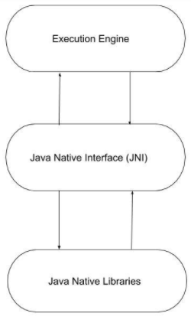
Java Native Interface(JNI)

